Slide 1
CONDUCTORS, DIELECTRICS AND CAPACITANCE

Slide 2
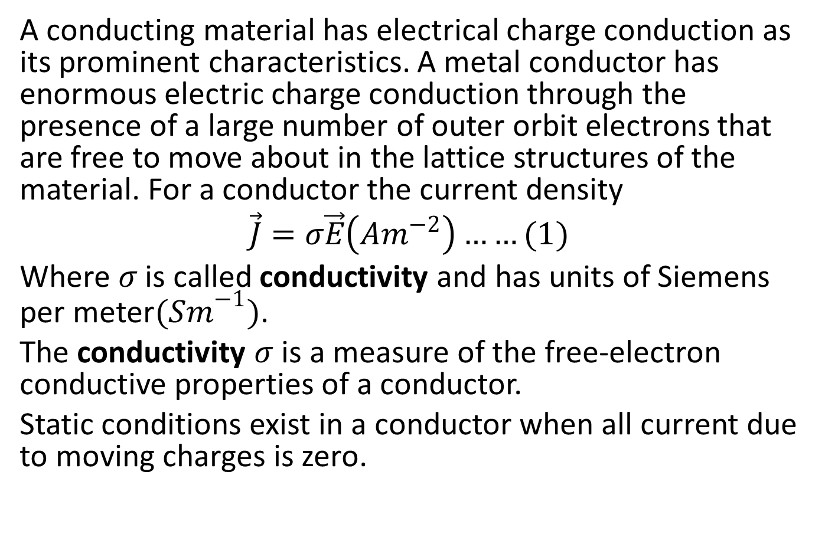
CONDUCTOR PROPERTIES UNDER STATIC CONDITIONS
A conducting material has electrical charge conduction as its prominent characteristics. A metal conductor has enormous electric charge conduction through the presence of a large number of outer orbit electrons that are free to move about in the lattice structures of the material. For a conductor the current density
$$\vec{J}=σ\vec{E}\left(Am^{−2}\right)……(1)$$
Where $σ$ is called conductivity and has units of Siemens per meter${(Sm}^{−1})$.
The conductivity $σ$ is a measure of the free-electron conductive properties of a conductor.
Static conditions exist in a conductor when all current due to moving charges is zero.

Slide 3
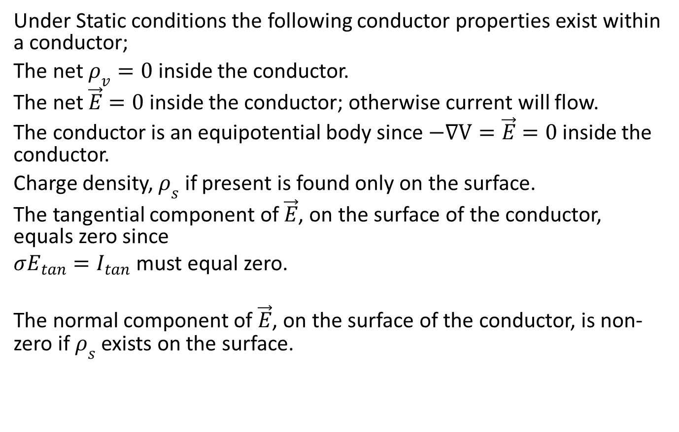
.
Under Static conditions the following conductor properties exist within a conductor;
The net $ρ_{v}=0$ inside the conductor.
The net $\vec{E}=0$ inside the conductor; otherwise current will flow.
The conductor is an equipotential body since $−∇V=\vec{E}=0$ inside the conductor.
Charge density, $ρ_{s}$ if present is found only on the surface.
The tangential component of $\vec{E}$, on the surface of the conductor, equals zero since
$σE_{tan}=I_{tan}$ must equal zero.
The normal component of $\vec{E}$, on the surface of the conductor, is non-zero if $ρ_{s}$ exists on the surface.

Slide 4
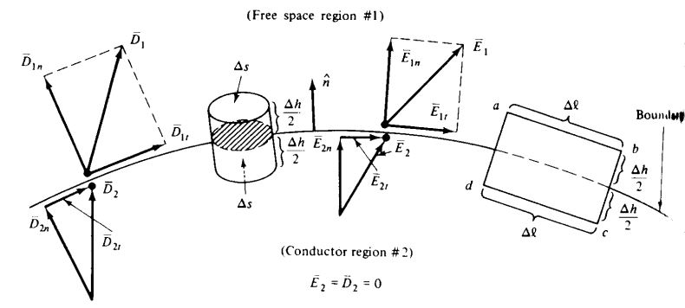
CONDUCTOR-FREE SPACE BOUNDARY CONDITIONS
Consider a conductor- free space boundary as shown below

Slide 5
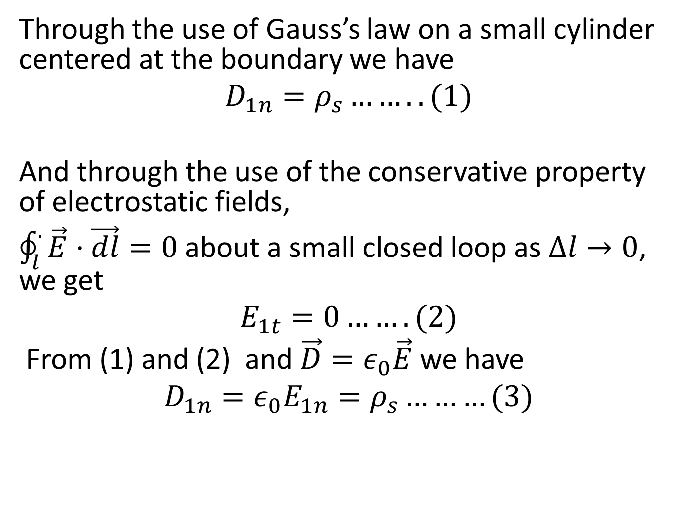
Through the use of Gauss’s law on a small cylinder centered at the boundary we have
$$D_{1n}=ρ_{s}……..(1)$$
And through the use of the conservative property of electrostatic fields,
$\oint_{l}^{.}{\vec{E}·\vec{dl}=0}$ about a small closed loop as $∆l→0$, we get
$$E_{1t}=0…….(2)$$
From (1) and (2) and $\vec{D}=ε_{0}\vec{E}$ we have
$$D_{1n}={ε_{0}E}_{1n}=ρ_{s}………(3)$$

Slide 6
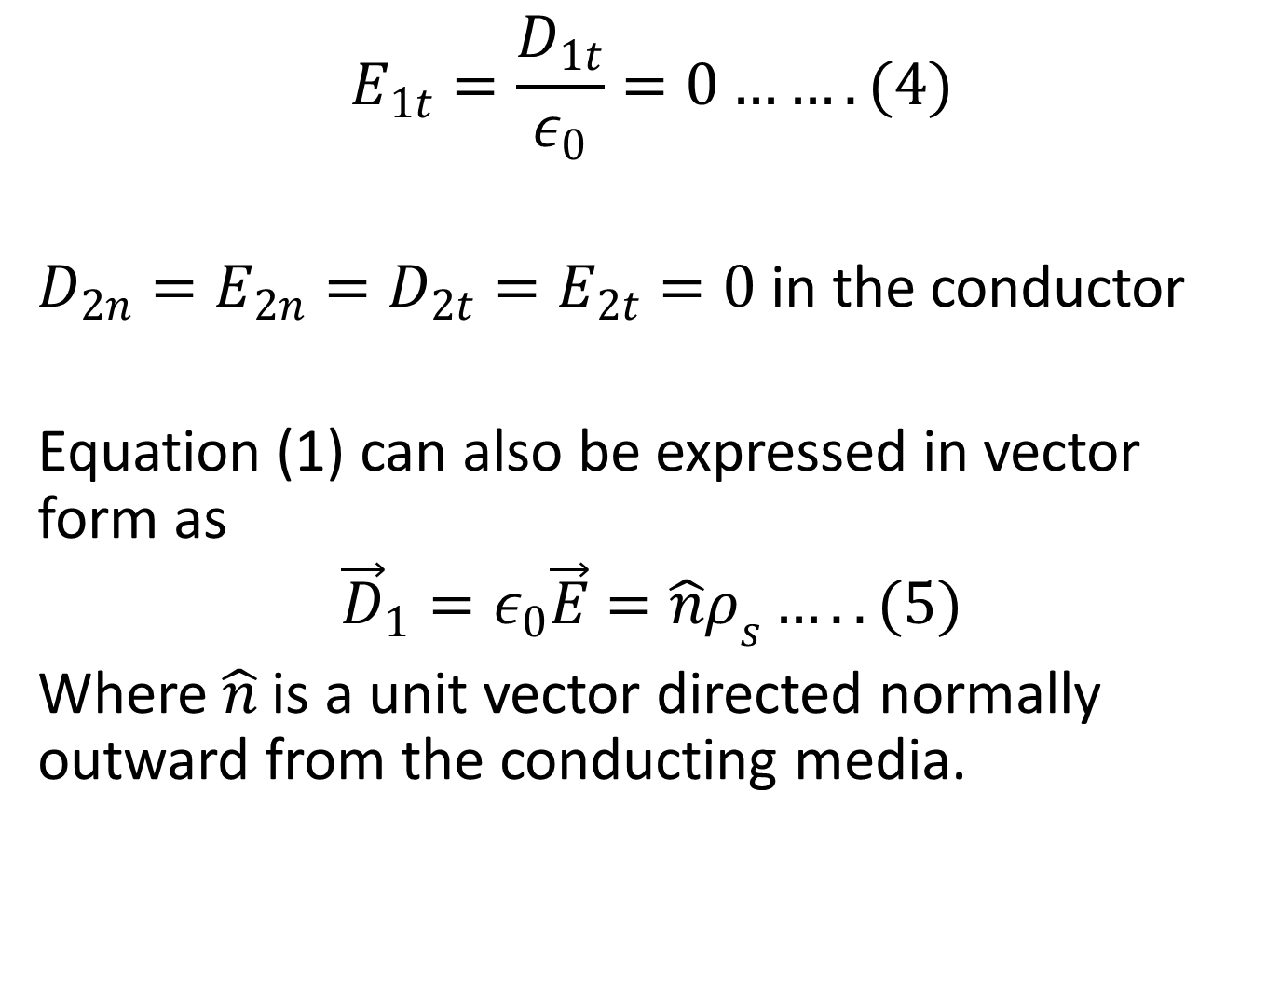
$$E_{1t}=\frac{D_{1t}}{ε_{0}}=0…….(4)$$
$D_{2n}=E_{2n}=D_{2t}=E_{2t}=0$ in the conductor
Equation (1) can also be expressed in vector form as
$${\vec{D}}_{1}=ε_{0}\vec{E}=\hat{n}ρ_{s}…..(5)$$
Where $\hat{n}$ is a unit vector directed normally outward from the conducting media.

Slide 7
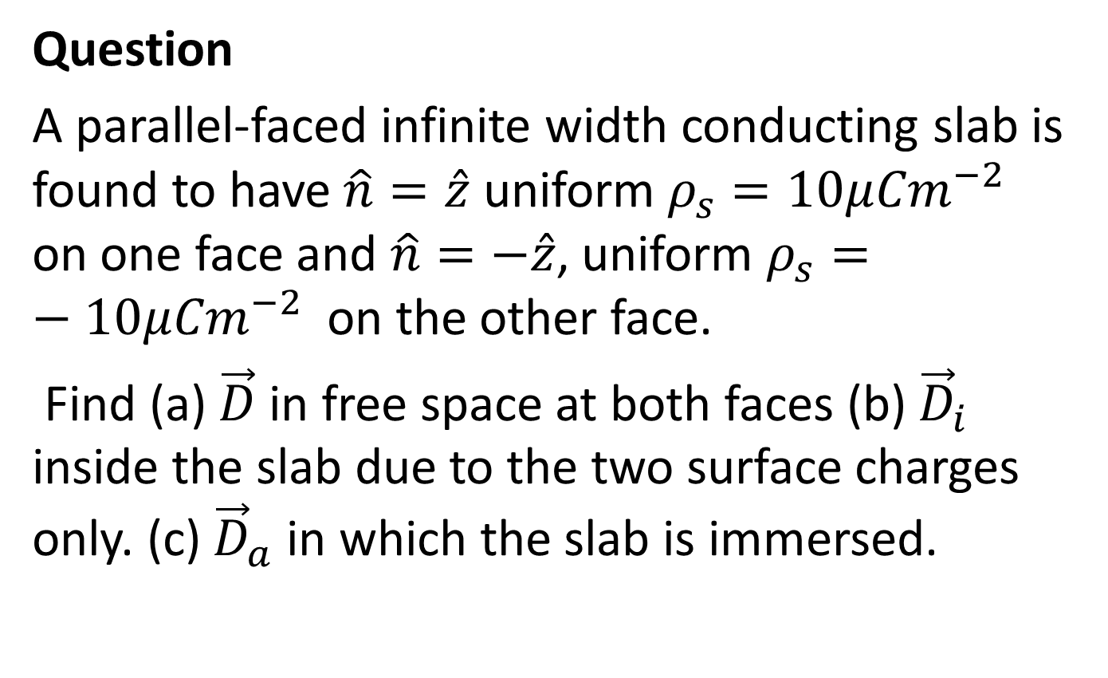
Question
A parallel-faced infinite width conducting slab is found to have $\hat{n}=\hat{z}$ uniform $ρ_{s}=10μ{Cm}^{−2}$ on one face and $\hat{n}=−\hat{z}$, uniform $ρ_{s}=−10μ{Cm}^{−2}$ on the other face.
Find (a)$\vec{D}$ in free space at both faces (b)${\vec{D}}_{i}$ inside the slab due to the two surface charges only. (c) ${\vec{D}}_{a}$ in which the slab is immersed.

Slide 8
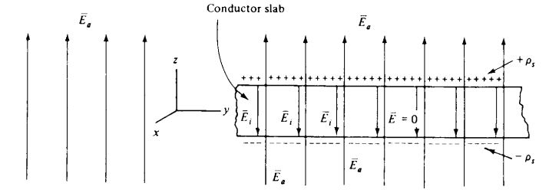
Solution

Slide 9
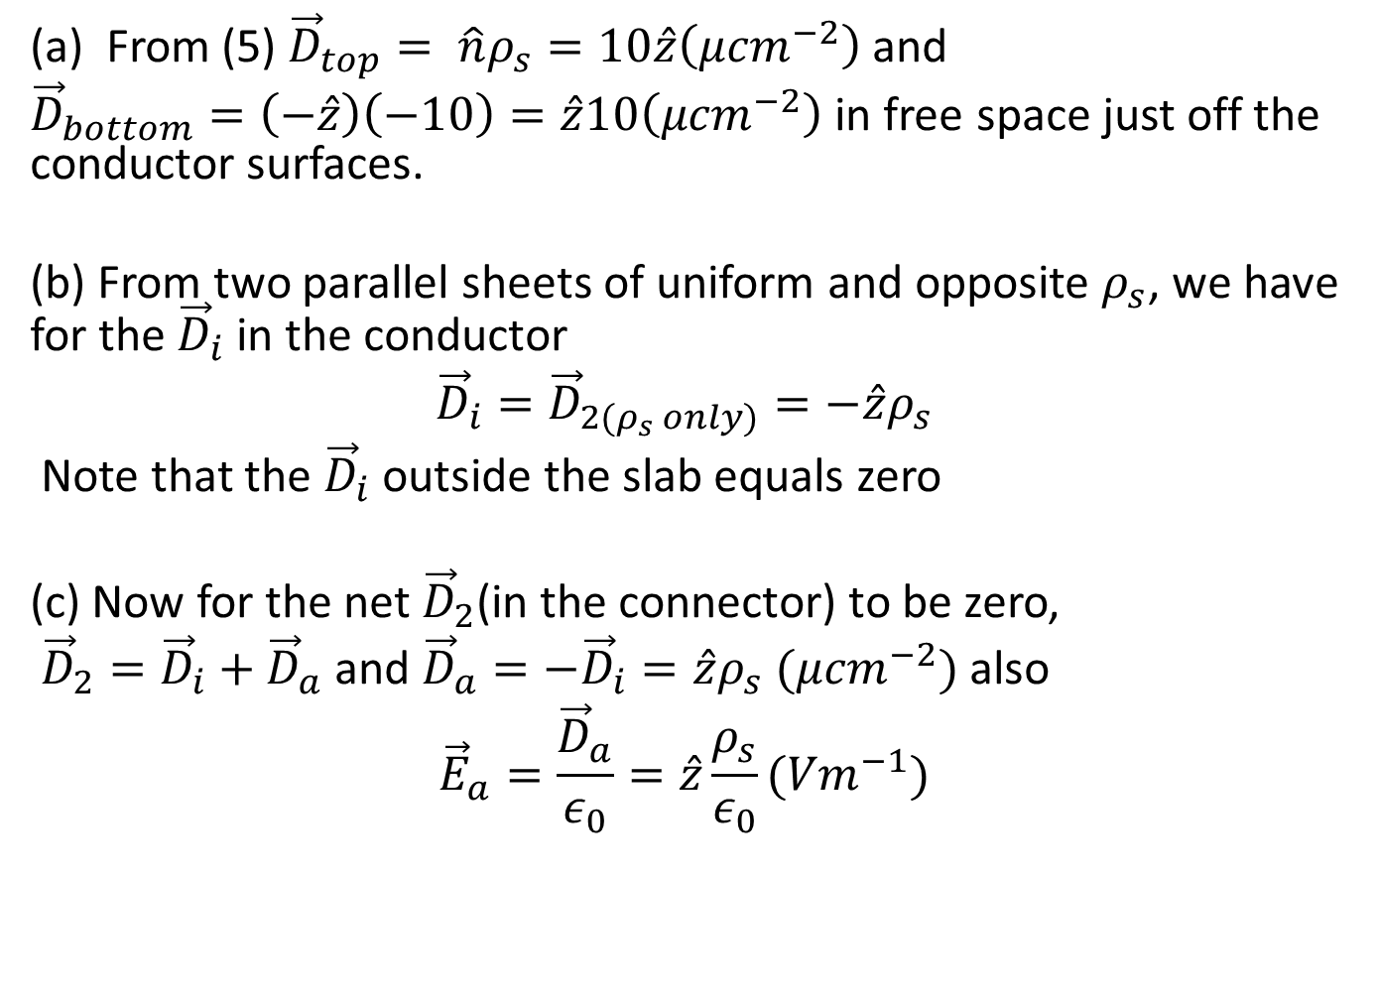
(a) From (5) ${\vec{D}}_{top}= \hat{n}ρ_{s}=10\hat{z}\left(μ{cm}^{−2}\right)$ and
${\vec{D}}_{bottom}=\left(−\hat{z}\right)\left(−10\right)=\hat{z}10\left(μ{cm}^{−2}\right)$ in free space just off the conductor surfaces.
(b) From two parallel sheets of uniform and opposite $ρ_{s}$, we have for the ${\vec{D}}_{i}$ in the conductor
$${\vec{D}}_{i}={\vec{D}}_{2(ρ_{s} only)}=−\hat{z}ρ_{s}$$
Note that the ${\vec{D}}_{i}$ outside the slab equals zero
(c) Now for the net ${\vec{D}}_{2}$(in the connector) to be zero,
${\vec{D}}_{2}={\vec{D}}_{i}+{\vec{D}}_{a}$ and ${\vec{D}}_{a}=−{\vec{D}}_{i}=\hat{z}ρ_{s} (μ{cm}^{−2})$ also
$${\vec{E}}_{a}=\frac{{\vec{D}}_{a}}{ε_{0}}=\hat{z}\frac{ρ_{s}}{ε_{0}}({Vm}^{−1})$$

Slide 10
DIELECTRICS (INSULATORS)
Poor conductors are commonly referred to as DIELECTRICS. The prominent characteristics of dielectric materials is POLARIZATION, i.e the formation of electric dipoles.
There are three basic polarization mechanisms that produce polarization, they are
Electronic polarization (exist in atom).
Ionic polarization (exist in molecule).
Orientational polarization (exist in polar materials with permanent dipole)

Slide 11
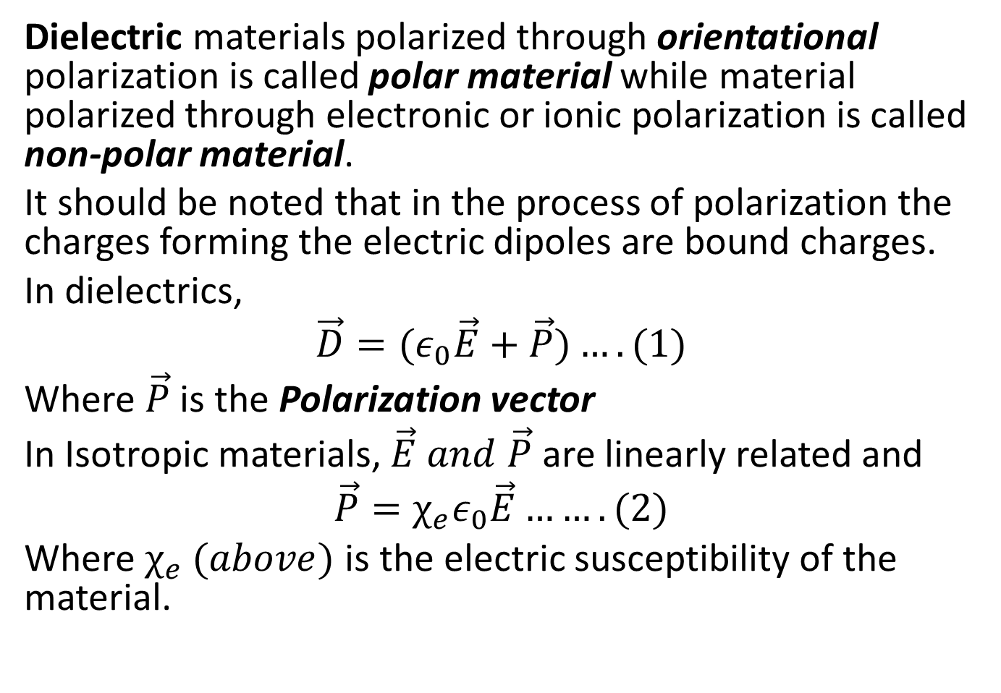
Dielectric materials polarized through orientational polarization is called polar material while material polarized through electronic or ionic polarization is called non-polar material.
It should be noted that in the process of polarization the charges forming the electric dipoles are bound charges.
In dielectrics,
$$\vec{D}={(ε}_{0}\vec{E}+\vec{P})….(1)$$
Where $\vec{P}$ is the Polarization vector
In Isotropic materials, $\vec{E} and \vec{P}$ are linearly related and
$$\vec{P}=χ_{e}ε_{0}\vec{E}…….(2)$$
Where $χ_{e}$ $(above)$ is the electric susceptibility of the material.

Slide 12
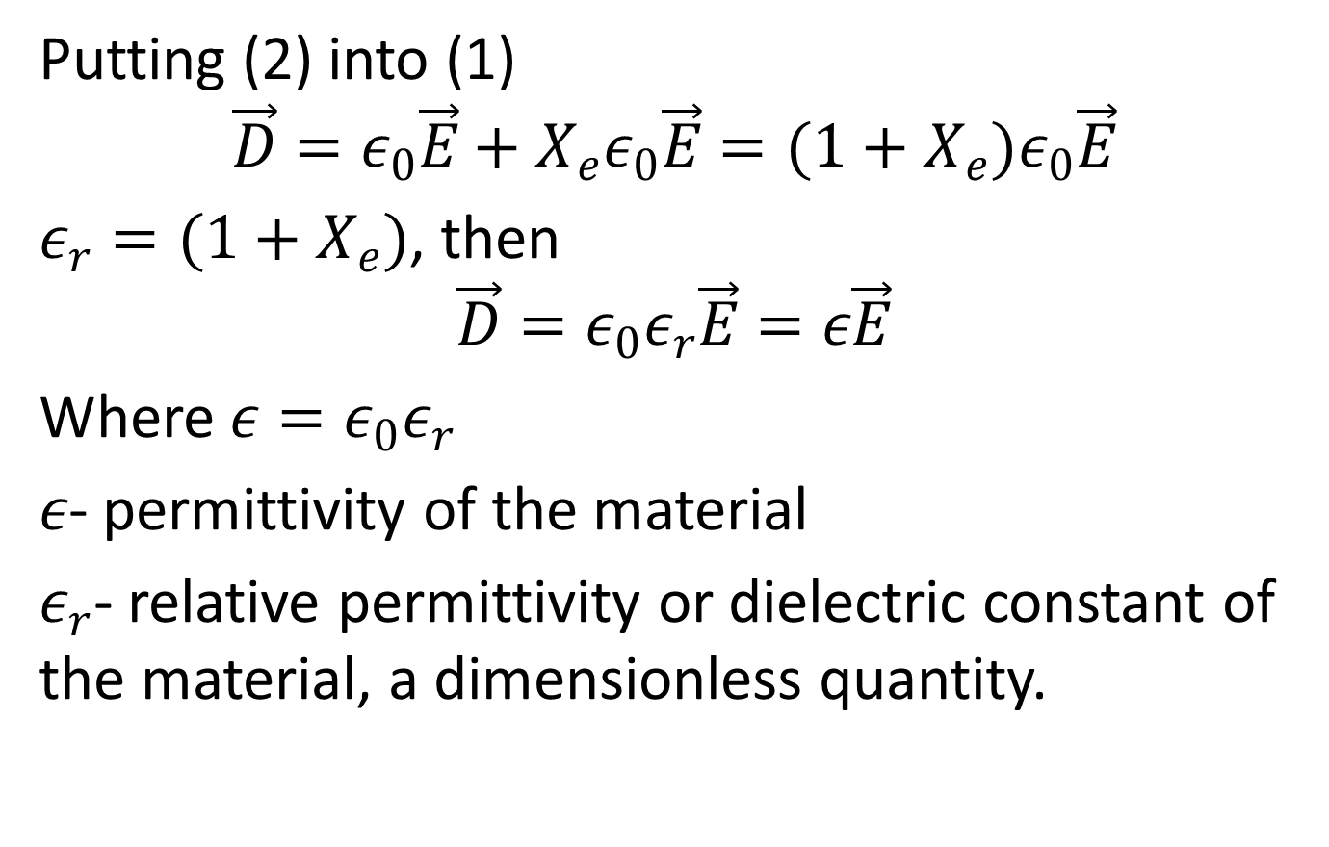
Putting (2) into (1)
$$\vec{D}=ε_{0}\vec{E}+X_{e}ε_{0}\vec{E}=(1+X_{e})ε_{0}\vec{E}$$
$ε_{r}=(1+X_{e})$, then
$$\vec{D}=ε_{0}ε_{r}\vec{E}=ε\vec{E}$$
Where $ε=ε_{0}ε_{r}$
$ε$- permittivity of the material
$ε_{r}$- relative permittivity or dielectric constant of the material, a dimensionless quantity.

Slide 13
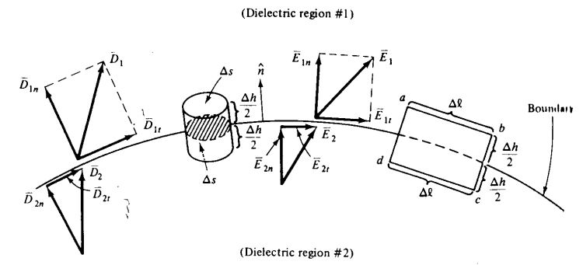

Dielectric- Dielectric Boundary Conditions
Let us now find the relationship between ${\vec{E}}_{is} and {\vec{D}}_{is}$ at a boundary between two dielectrics as shown below

Slide 14
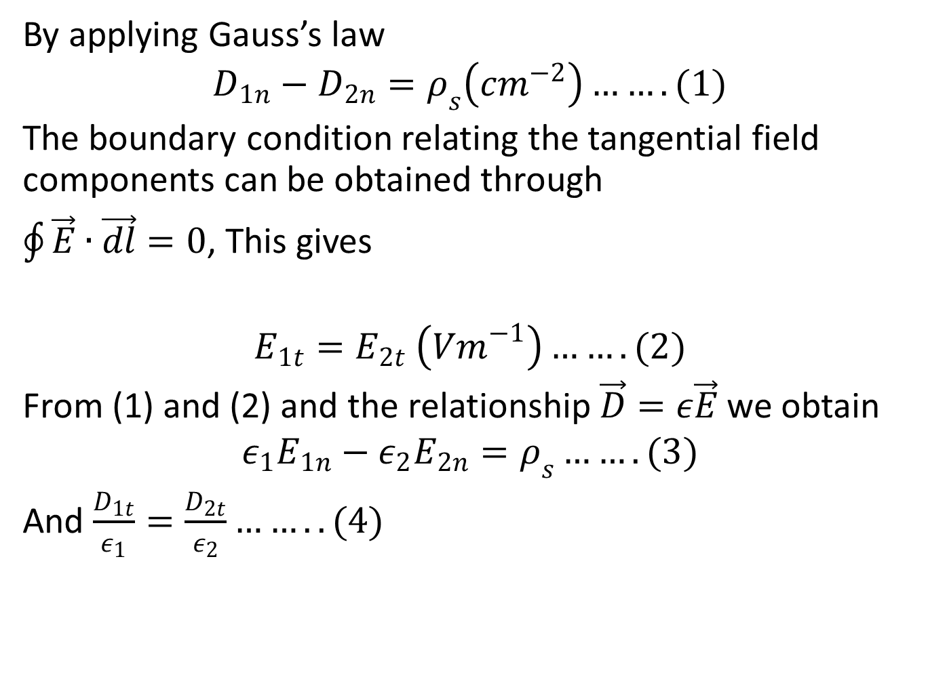
By applying Gauss’s law
$$D_{1n}−D_{2n}=ρ_{s}\left({cm}^{−2}\right)…….(1)$$
The boundary condition relating the tangential field components can be obtained through
$\oint{\vec{E}∙\vec{dl}=0}$, This gives
$$E_{1t}=E_{2t} \left({Vm}^{−1}\right)…….(2)$$
From (1) and (2) and the relationship $\vec{D}=ε\vec{E}$ we obtain
$$ε_{1}E_{1n}−ε_{2}E_{2n}=ρ_{s}…….(3)$$
And $\frac{D_{1t}}{ε_{1}}=\frac{D_{2t}}{ε_{2}}……..(4)$

Slide 15
Equations (1) to (4) make up the set of boundary conditions at a dielectric-dielectric boundary.

Slide 16
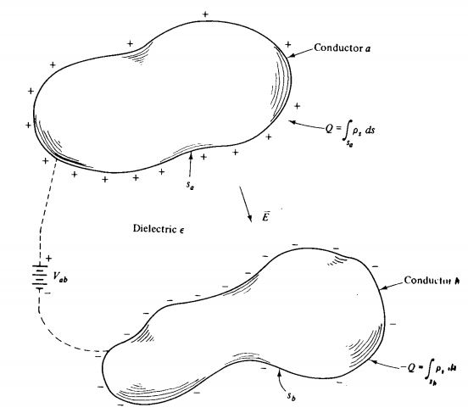
CAPACITANCE

Slide 17
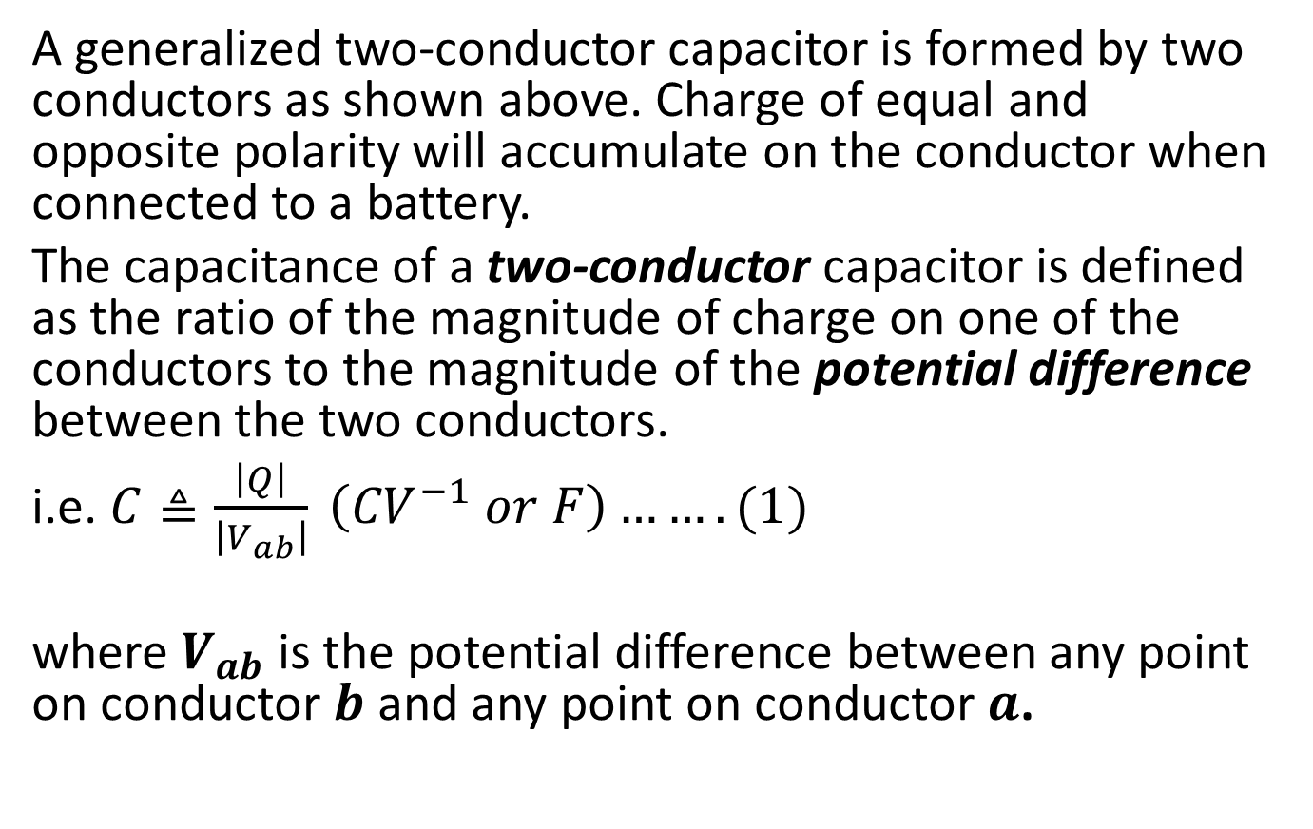
A generalized two-conductor capacitor is formed by two conductors as shown above. Charge of equal and opposite polarity will accumulate on the conductor when connected to a battery.
The capacitance of a two-conductor capacitor is defined as the ratio of the magnitude of charge on one of the conductors to the magnitude of the potential difference between the two conductors.
i.e. $C≜\frac{\left|Q\right|}{\left|V_{ab}\right|} \left({CV}^{−1} or F\right)…….(1)$
where $V_{ab}$ is the potential difference between any point on conductor $b$ and any point on conductor $a$.

Slide 18
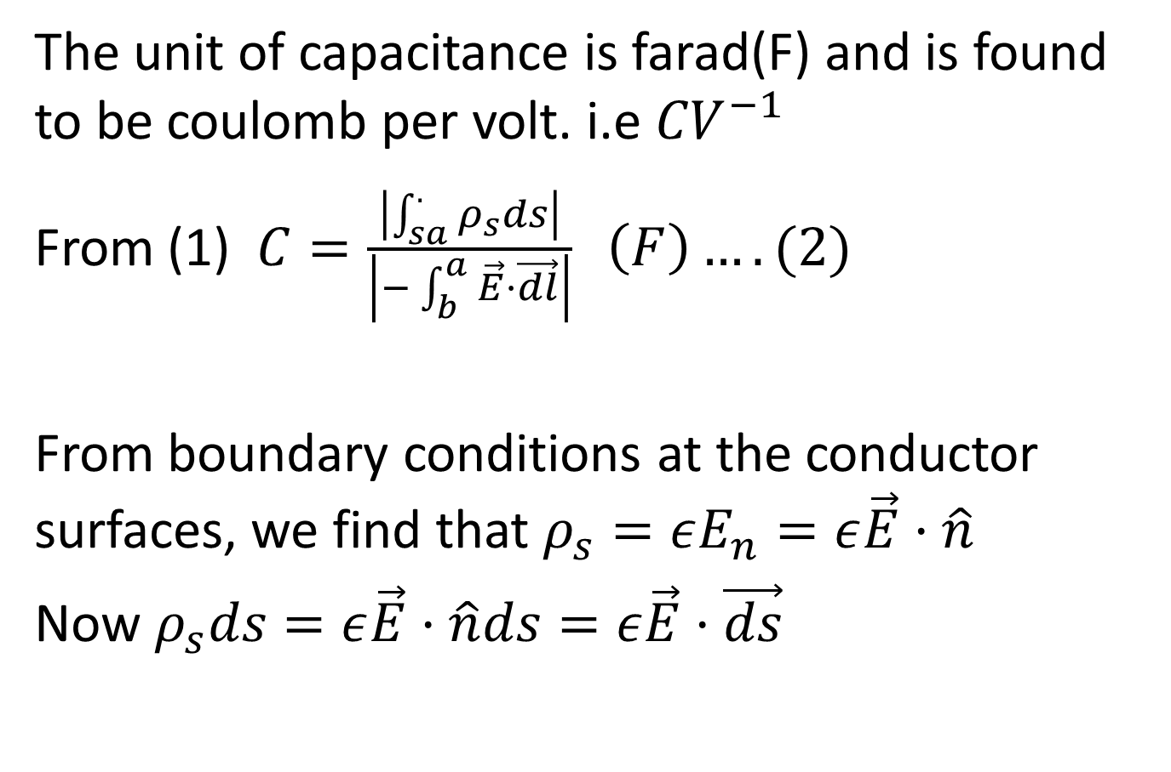
The unit of capacitance is farad(F) and is found to be coulomb per volt. i.e ${CV}^{−1}$
From (1) $C=\frac{\left|\int_{sa}^{.}{ρ_{s}ds}\right|}{\left|−\int_{b}^{a}{\vec{E}·\vec{dl}}\right|} \left(F\right)….(2)$
From boundary conditions at the conductor surfaces, we find that $ρ_{s}=εE_{n}=ε\vec{E}·\hat{n}$
Now $ρ_{s}ds=ε\vec{E}·\hat{n}ds=ε\vec{E}·\vec{ds}$

Slide 19
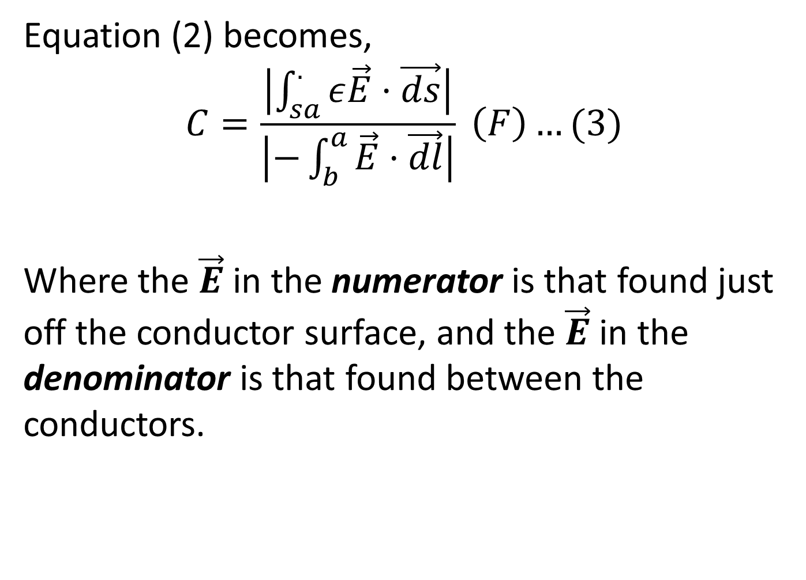
Equation (2) becomes,
$$C=\frac{\left|\int_{sa}^{.}{ε\vec{E}·\vec{ds}}\right|}{\left|−\int_{b}^{a}{\vec{E}·\vec{dl}}\right|} \left(F\right)…(3)$$
Where the $\vec{E}$ in the numerator is that found just off the conductor surface, and the $\vec{E}$ in the denominator is that found between the conductors.

Slide 20
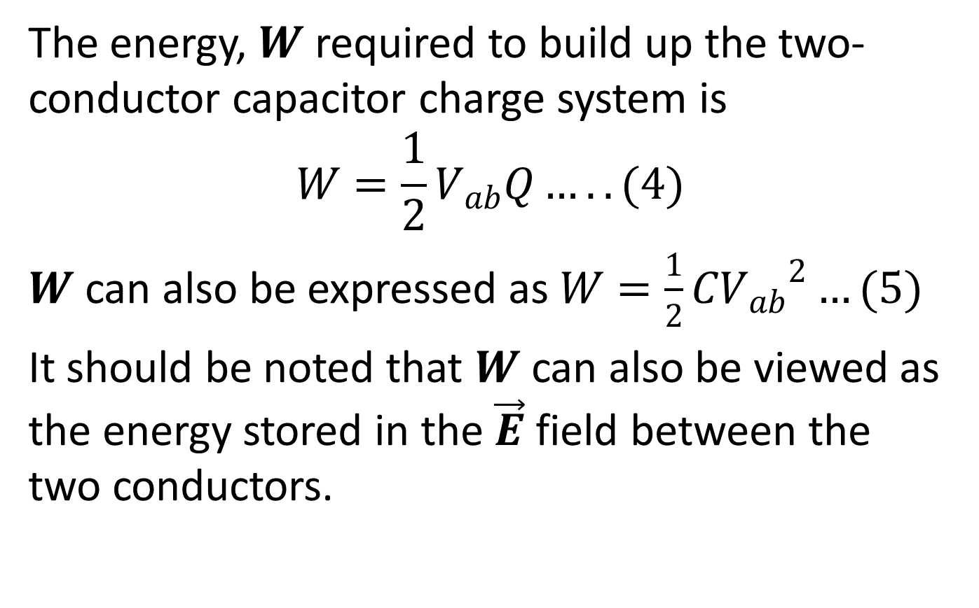
The energy, $W$ required to build up the two-conductor capacitor charge system is
$$W=\frac{1}{2}V_{ab}Q…..(4)$$
$W$ can also be expressed as $W=\frac{1}{2}C{V_{ab}}^{2}…(5)$
It should be noted that $W$ can also be viewed as the energy stored in the $\vec{E}$ field between the two conductors.

Slide 21
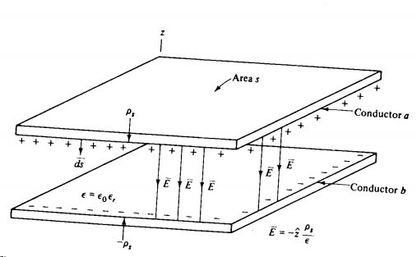
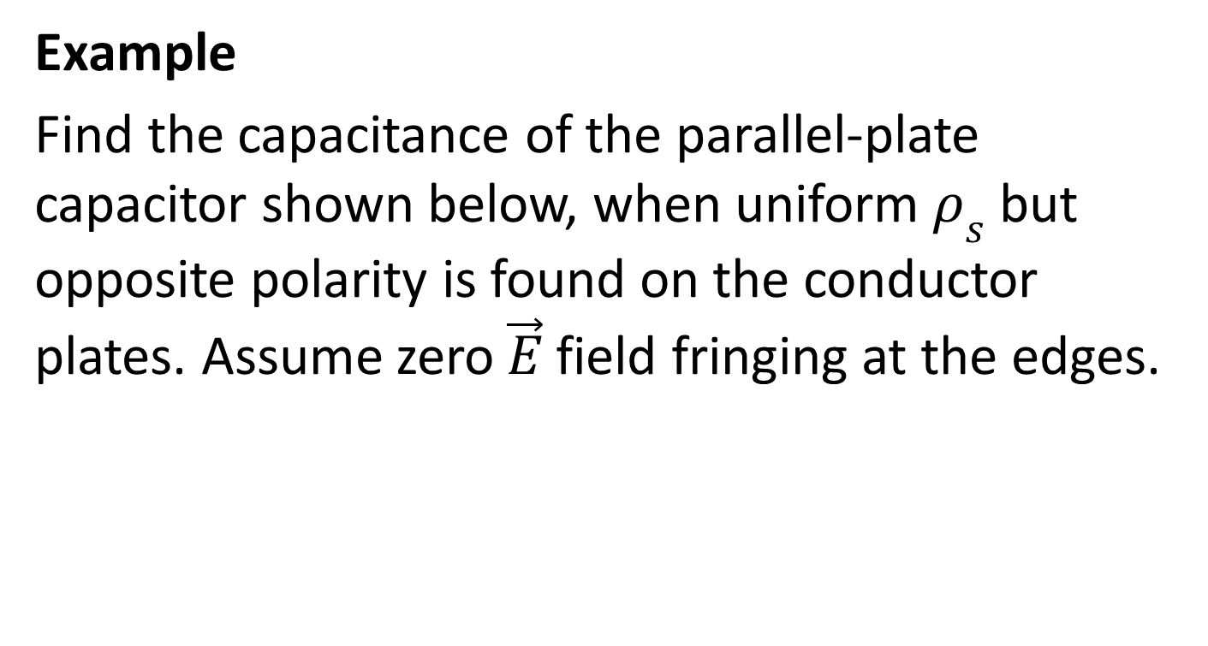
Example
Find the capacitance of the parallel-plate capacitor shown below, when uniform $ρ_{s}$ but opposite polarity is found on the conductor plates. Assume zero $\vec{E}$ field fringing at the edges.

Slide 22
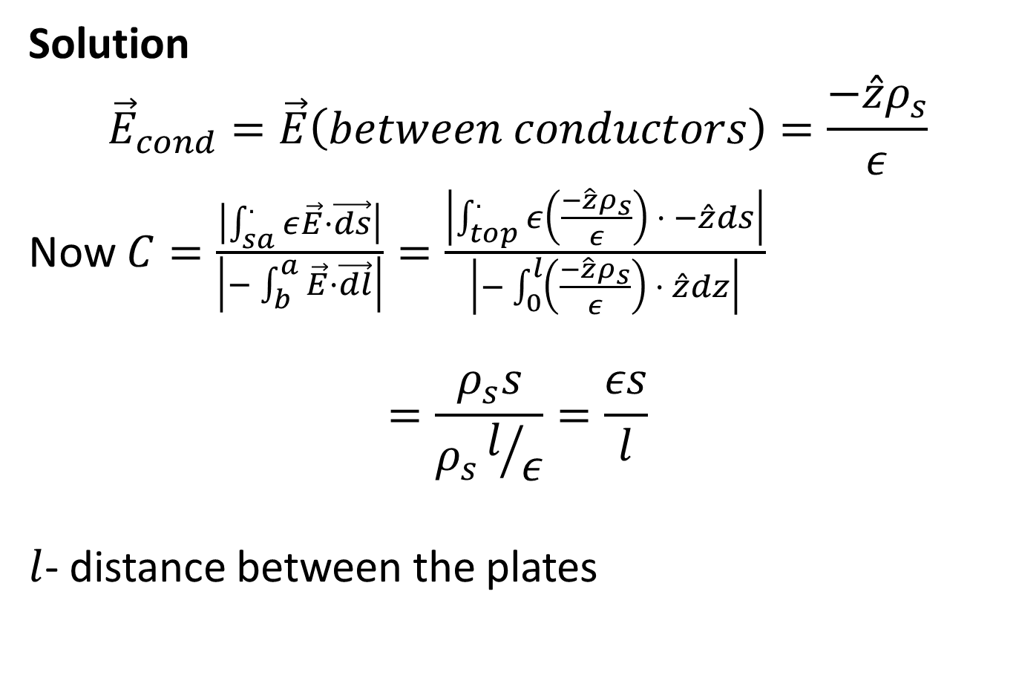
Solution
$${\vec{E}}_{cond}=\vec{E}\left(between conductors\right)=\frac{−\hat{z}ρ_{s}}{ε}$$
Now $C=\frac{\left|\int_{sa}^{.}{ε\vec{E}·\vec{ds}}\right|}{\left|−\int_{b}^{a}{\vec{E}·\vec{dl}}\right|}=\frac{\left|\int_{top}^{.}{ε\left(\frac{−\hat{z}ρ_{s}}{ε}\right) · −\hat{z}ds}\right|}{\left|−\int_{0}^{l}{\left(\frac{−\hat{z}ρ_{s}}{ε}\right) · \hat{z}dz}\right|}$
$$=\frac{ρ_{s}s}{ρ_{s}l/ε}=\frac{εs}{l}$$
$l$- distance between the plates

Slide 23
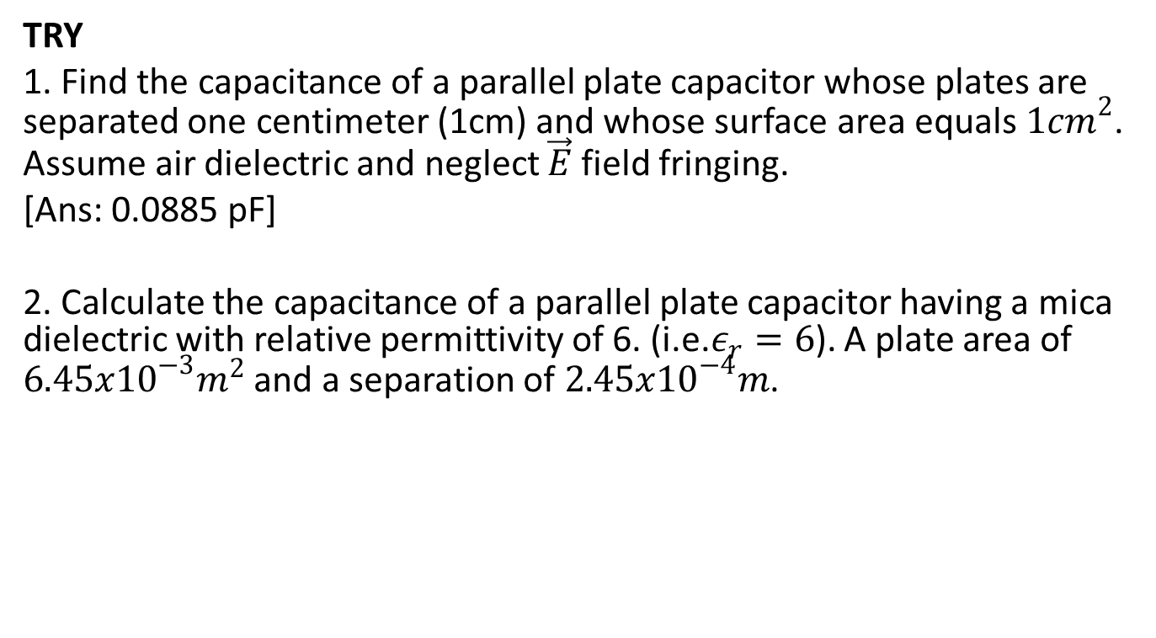
TRY
1. Find the capacitance of a parallel plate capacitor whose plates are separated one centimeter (1cm) and whose surface area equals ${1cm}^{2}$. Assume air dielectric and neglect $\vec{E}$ field fringing.
[Ans: 0.0885 pF]
2. Calculate the capacitance of a parallel plate capacitor having a mica dielectric with relative permittivity of 6. (i.e.$ε_{r}=6$). A plate area of $6.45x{10}^{−3}m^{2}$ and a separation of $2.45x{10}^{−4}m$.

Slide 24
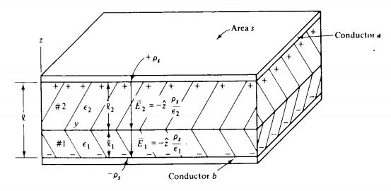

Slide 25
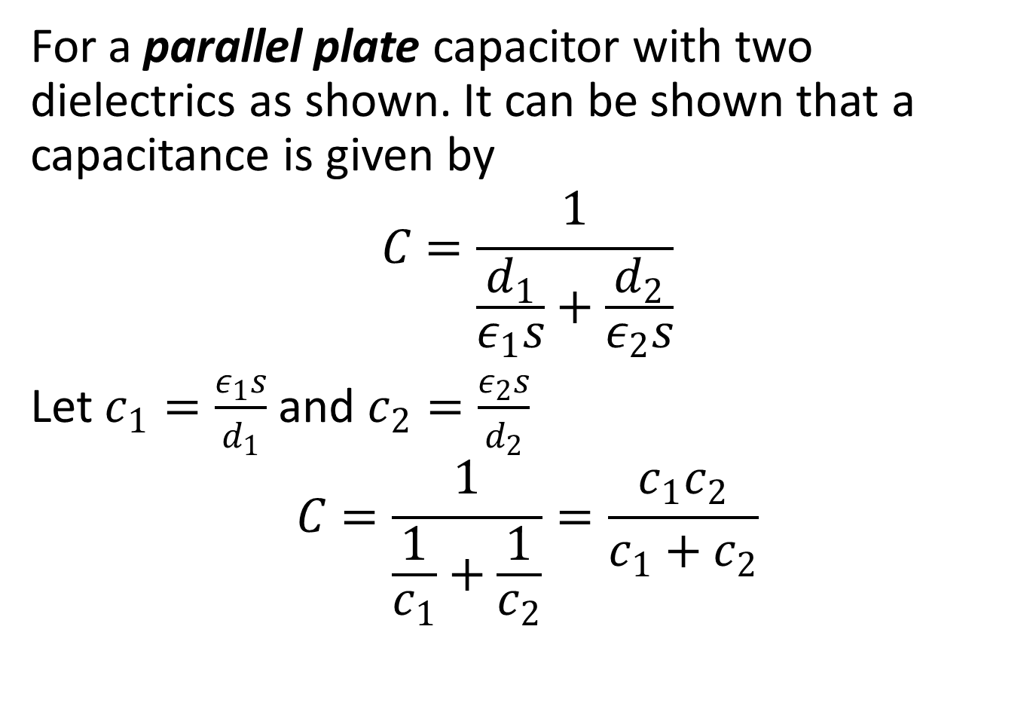
For a parallel plate capacitor with two dielectrics as shown. It can be shown that a capacitance is given by
$$C=\frac{1}{\frac{d_{1}}{ε_{1}s}+\frac{d_{2}}{ε_{2}s}}$$
Let $c_{1}=\frac{ε_{1}s}{d_{1}}$ and $c_{2}=\frac{ε_{2}s}{d_{2}}$
$$C=\frac{1}{\frac{1}{c_{1}}+\frac{1}{c_{2}}}=\frac{c_{1}c_{2}}{c_{1}+c_{2}}$$

Slide 26
This is equivalent to capacitors in series.

